Slide 1
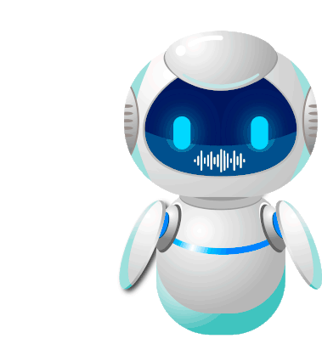
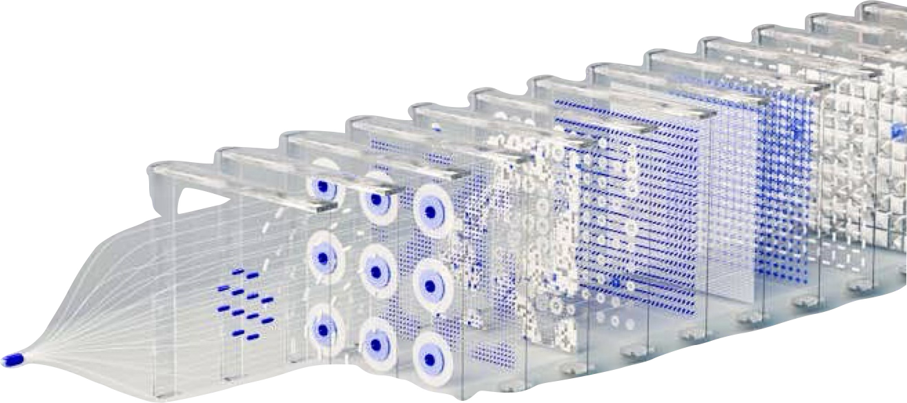
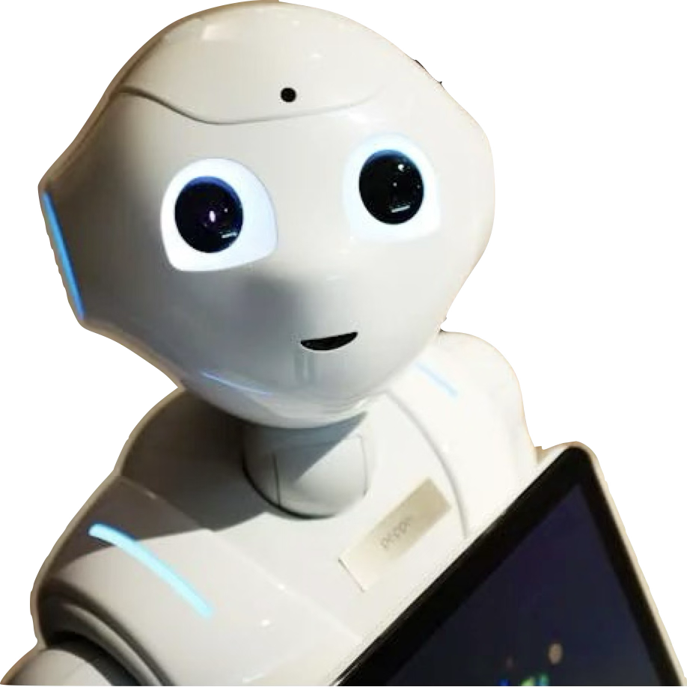
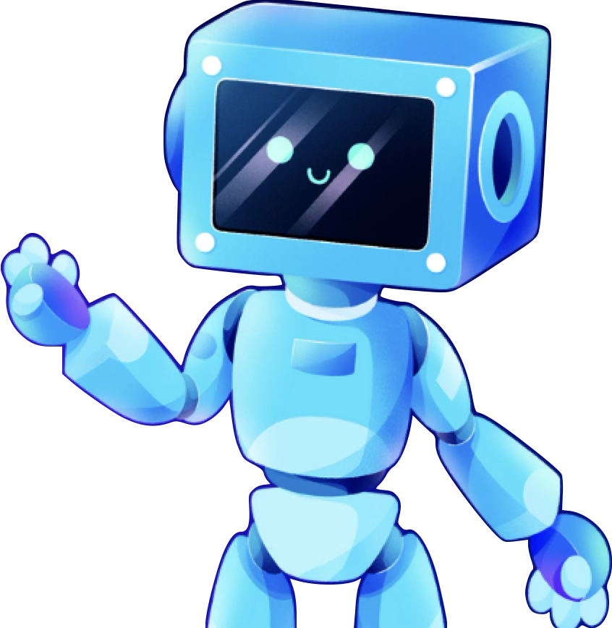
DreamBridge AI : Your AI-Powered Path to Success
Redefining Career Guidance with Intelligence, Empathy, and Precision

Slide 2
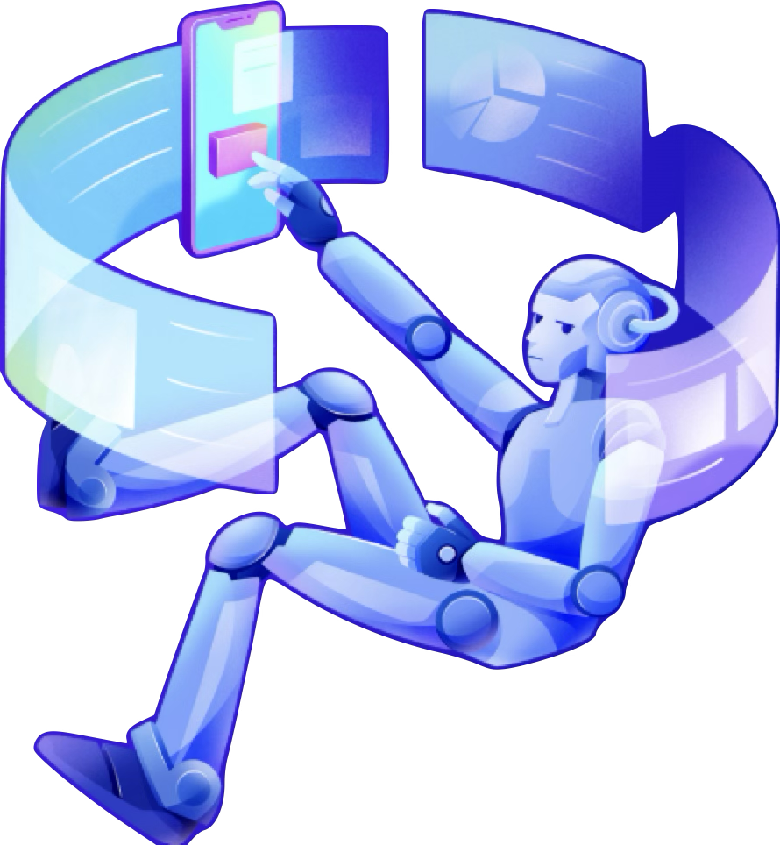



👨‍👦‍👦 Team Name:NxtGenNavigator
Madhura Abnave
Pragyan Gupta
Shrutika Malve
AI Engineer
AI Engineer
Full stack Developer

Slide 3
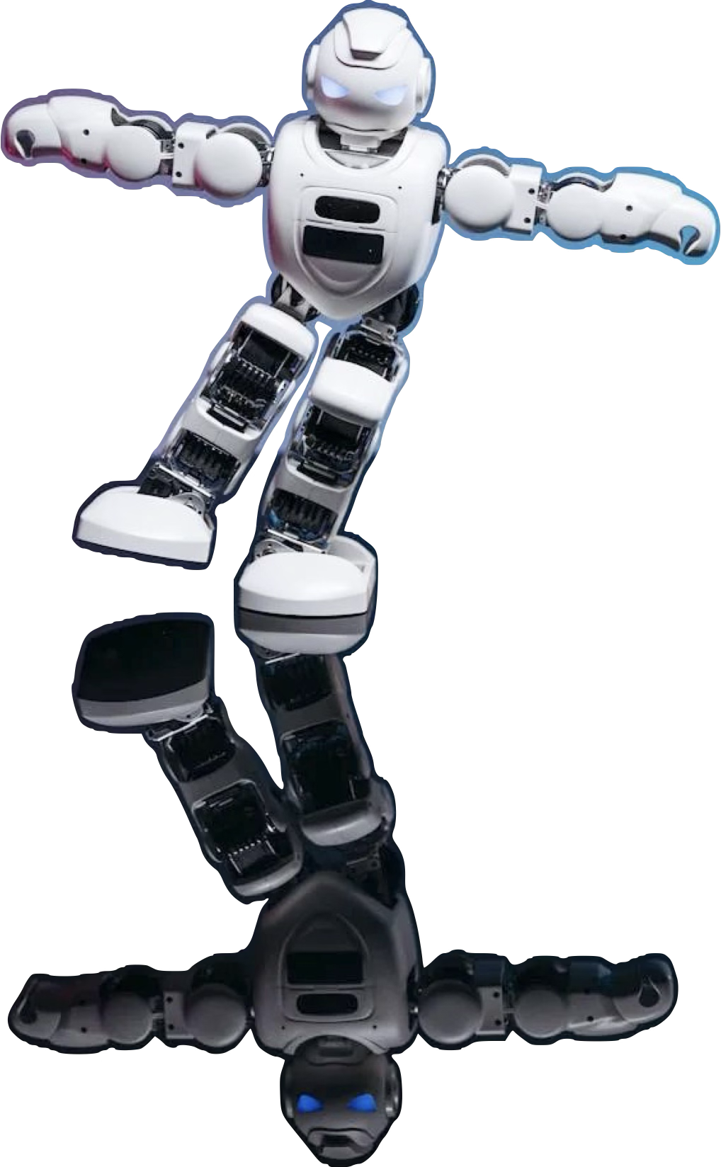
🚩 Problem statement details
Problem Statement
The job market is evolving rapidly, creating a growing need for accessible, personalized, and adaptive career guidance. Traditional career counseling methods often fall short in the following areas:
Scalability: Inability to cater to a large number of users simultaneously.
Emotional Engagement: Lack of empathetic and emotionally intelligent interactions.
Real-Time Adaptability: Inadequate in addressing dynamic user profiles, skills, and market trends.
Bias and Inclusivity: Struggles to ensure unbiased recommendations for diverse user demographics.
This gap creates challenges for individuals in finding career paths that align with their skills, aspirations, and market opportunities. There is a pressing need for a scalable and intelligent solution that adapts to the unique requirements of each user.
Objective
To develop an AI-driven platform that provides personalized career guidance through:
Tailored recommendations based on individual skills, preferences, and market data.
Emotional intelligence in interactions to simulate human-like counseling.
Bias mitigation to ensure inclusivity and fairness.
Continuous feedback to improve user experience and adapt to market changes.

Slide 4
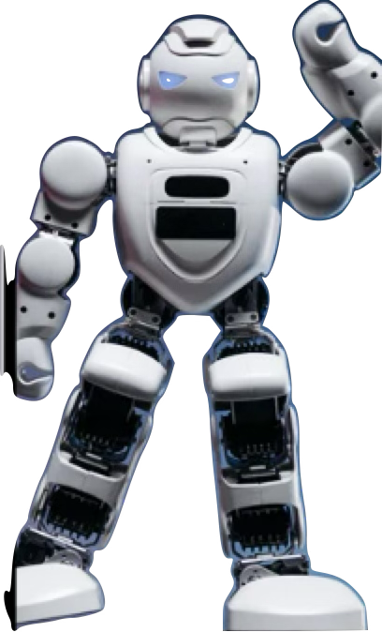
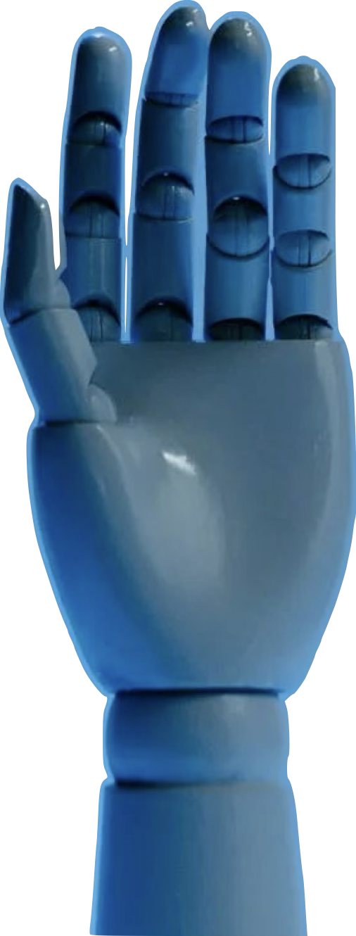
📝 Theme
AI-Based Model Career Hub / Counsellor
🌟 Introducing AI-Powered Career Counselor
💼 The Current Market
By 2030, 375M workers (14% globally) will need new skills or roles. (McKinsey)
85% of professionals feel unprepared for evolving job markets due to a lack of personalized guidance.
📊 Challenges in Career Counseling
Generic Advice: One-size-fits-all solutions fail to meet unique needs.
Scalability: Traditional counseling cannot cater to millions effectively.
Bias: Inequity in guidance limits inclusivity and fairness.
🚀 Why AI?
AI provides real-time, adaptive, and personalized guidance, empowering individuals in a rapidly changing world.
Delivers emotionally intelligent, unbiased support to address diverse aspirations.
💡 Addressing a Critical Need
The rapidly evolving job market leaves individuals struggling to navigate career opportunities.
Traditional career counseling methods are outdated and lack scalability, personalization, and adaptability.
This solution bridges the gap with personalized, scalable, and adaptive guidance, empowering individuals to achieve their potential.
🌍 Massive Impact Potential
With over 300M professionals worldwide seeking career advice, this solution can redefine the future of counseling.
Beyond individual impact, it shapes industries by connecting talent with opportunities and addressing the growing demand for skilled professionals.
Innovation + Empathy + Accessibility = A game-changer in career guidance.

Slide 5
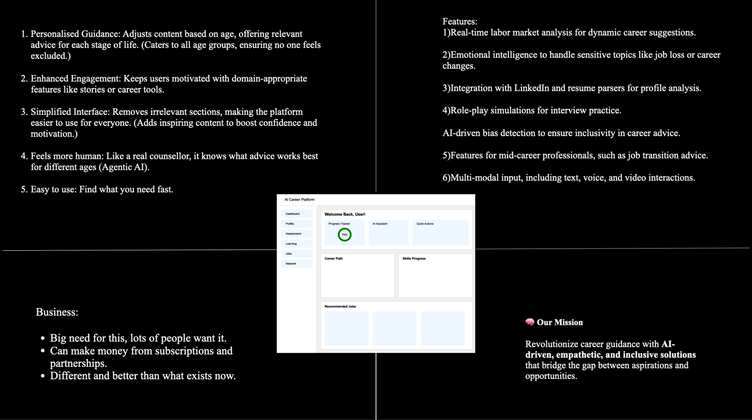

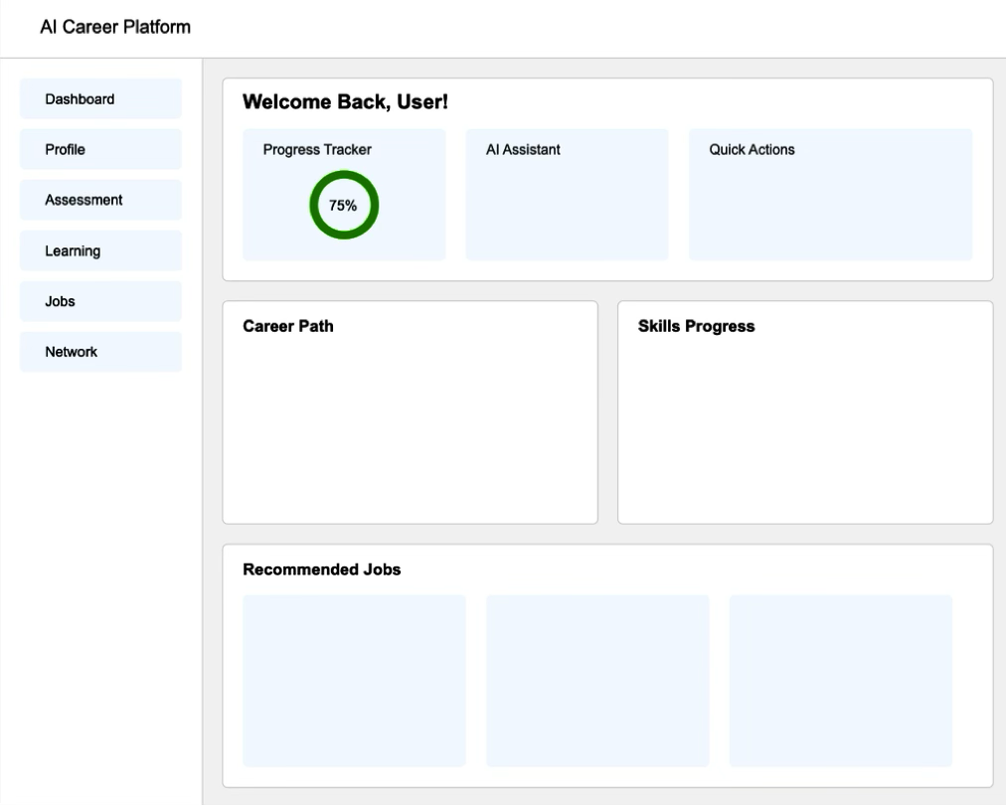
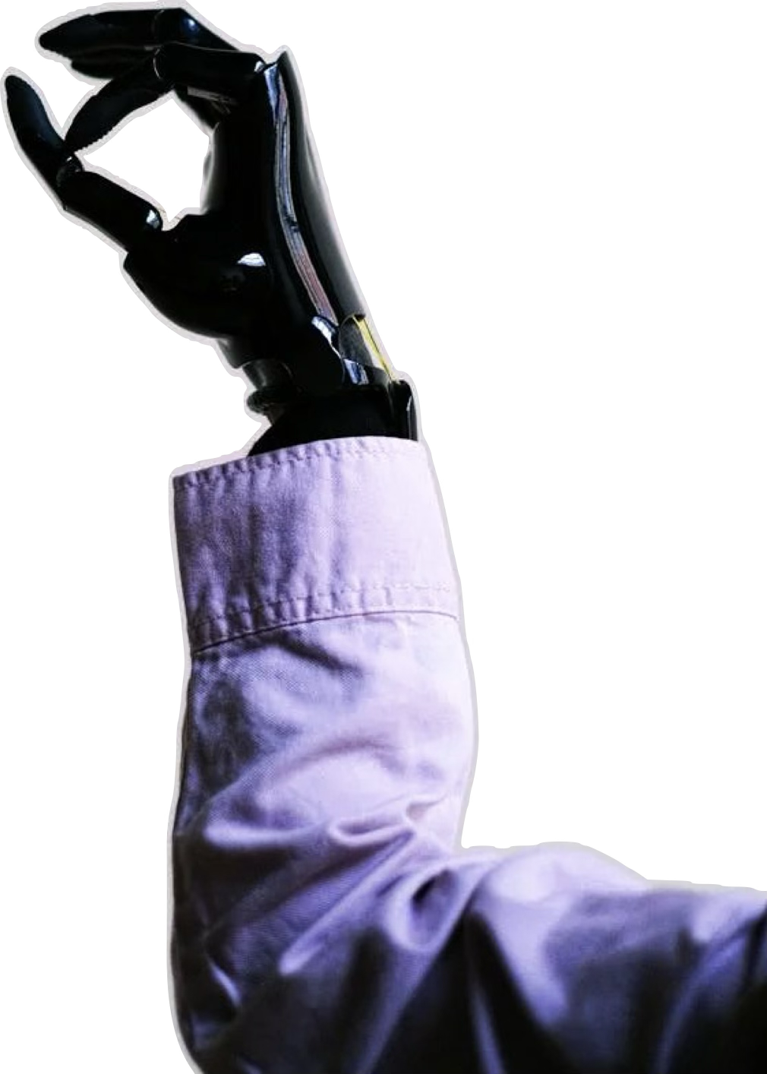
How it helps to solve the problem?

Slide 6
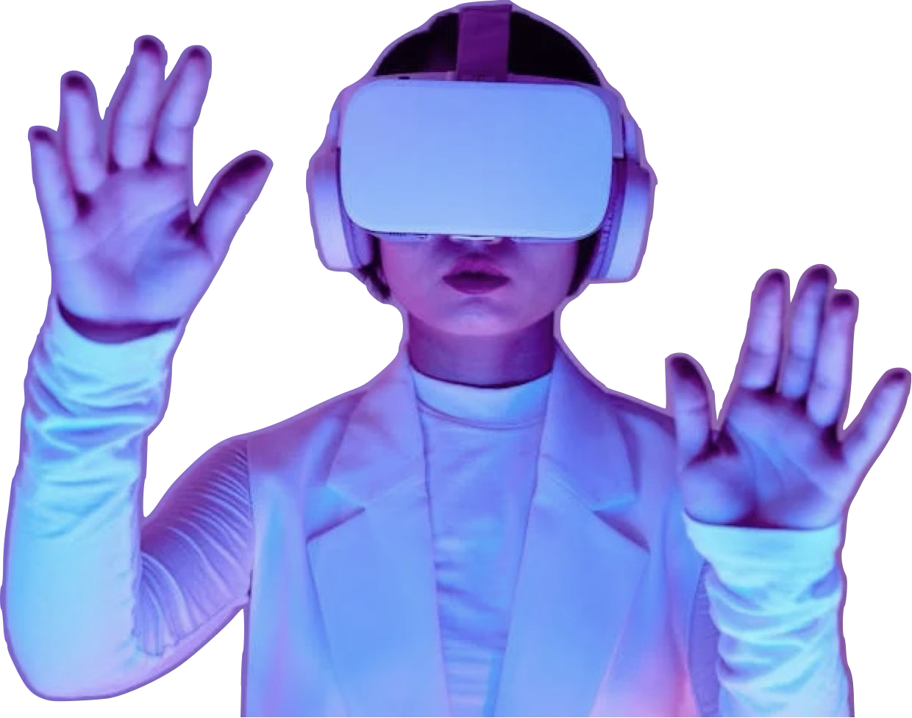
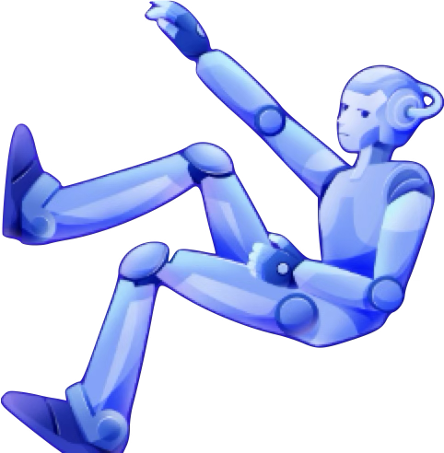
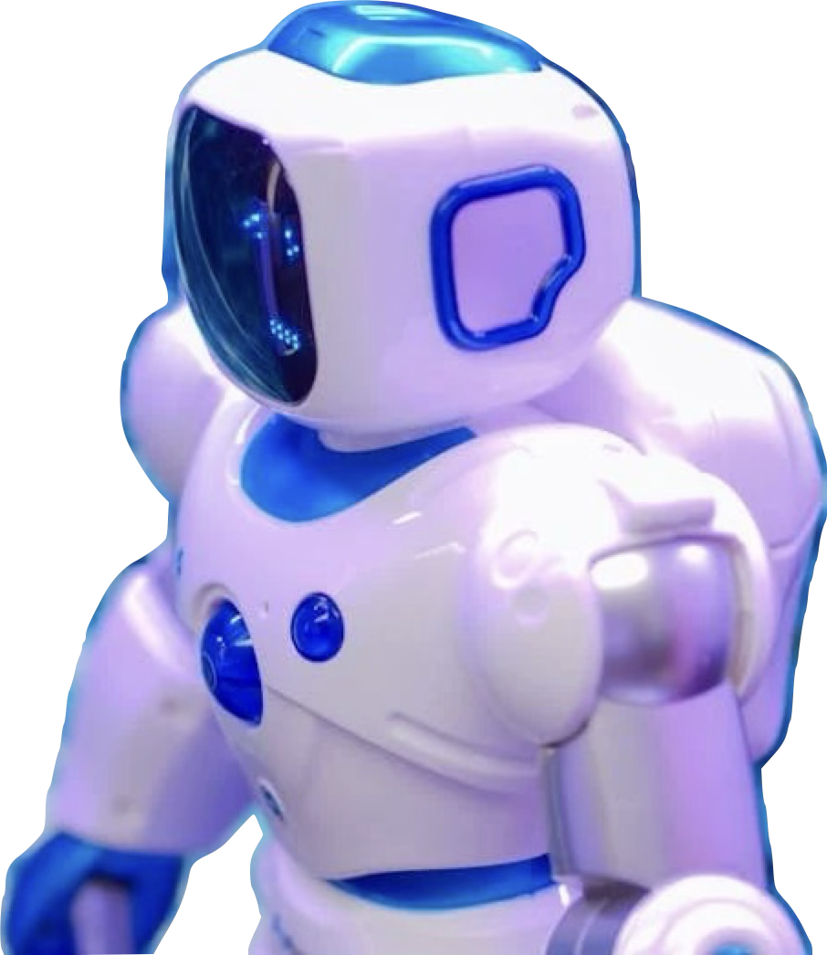
Assumptions:
Users have basic digital literacy.
Reliable internet access is available.
Sufficient data exists for training AI models.
Constraints:
AI development requires significant computing resources.
Ensuring data privacy and security is crucial.
Mitigating bias in AI models is an ongoing challenge.
Solution Decisions:
Long Chain for its ability to create interactive, goal-driven AI agents.
Cloud platforms for scalability and cost-effectiveness.
GPT-4 for its advanced language understanding and reasoning capabilities.
Scalability/Usability:
Cloud-based architecture allows for high scalability.
User-friendly interface and personalized experience enhance usability.
Implementation & Effectiveness:
Implementation requires expertise in AI/ML, software development, and UX design.
Effectiveness depends on data quality, model accuracy, and user adoption.

Slide 7
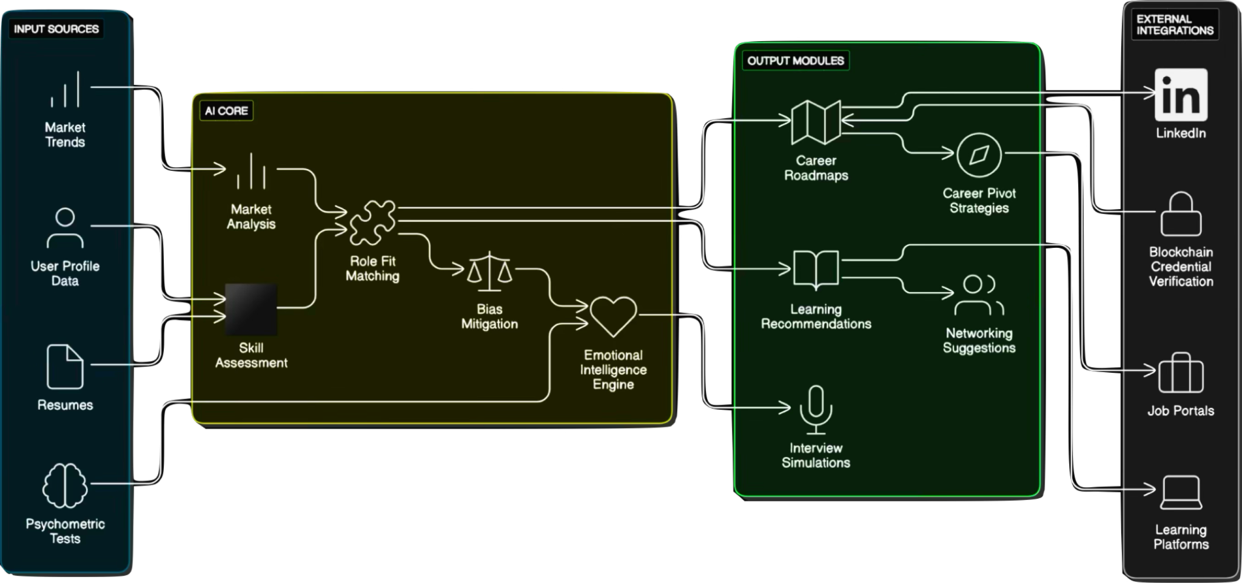

ARCHITECTURE DIAGRAM
DreamBridge AI:Leveraging AI agents and Agentic AI for Personalized Career Guidance.
Agents in Our Workflow :
User Profile Agent: Handles profile creation, updates, and psychometric inputs, ensuring a strong foundation for personalized career guidance.
Data Analysis Agent: Processes user data, market trends, and skills to generate actionable insights, feeding the system's intelligence.
Role Matching Agent: Matches skills, interests, and market demands while addressing biases and integrating emotional intelligence for fair and empathetic recommendations.
Career Guidance Agent: Provides tailored advice, including career roadmaps, learning suggestions, and strategies for role transitions, enhancing user outcomes.
Feedback & Improvement Agent: Continuously collects user feedback and refines recommendations, ensuring the system adapts and improves over time.

Slide 8
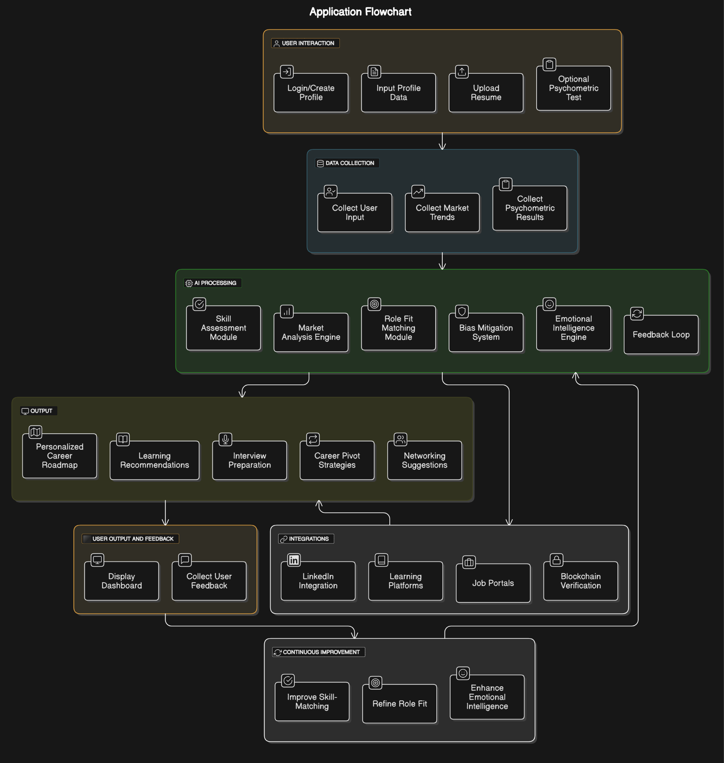
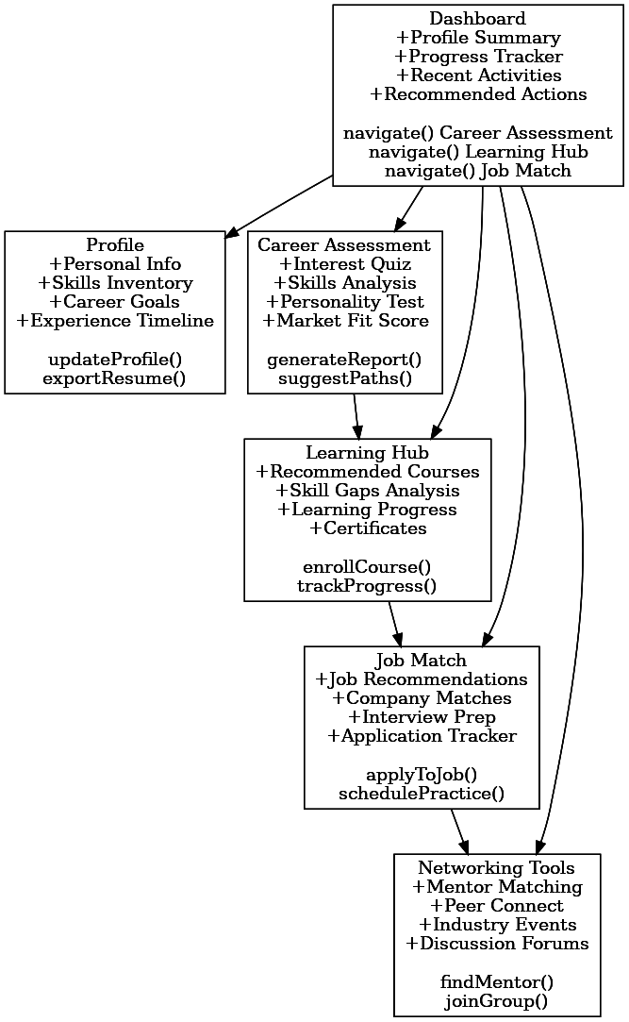


FlowChart
WireFrame
Left sidebar contains main navigation menu with quick access to Dashboard, Profile, Assessment, Learning, Jobs, and Network sections.
Top header displays platform logo, search bar, and user profile settings for easy accessibility across all screens.
Main content area shows personalized widgets including progress tracker, AI assistant chat, and action items specific to user's career journey.
Card-based layout presents job recommendations, skill assessments, and learning modules in an organized grid system.
Bottom section features an interactive timeline showing career roadmap, upcoming events, and milestone tracking with visual progress indicators.

Slide 9
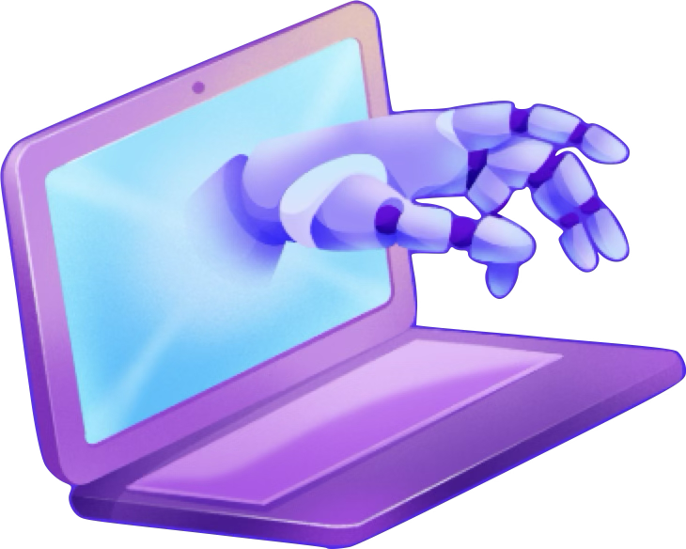








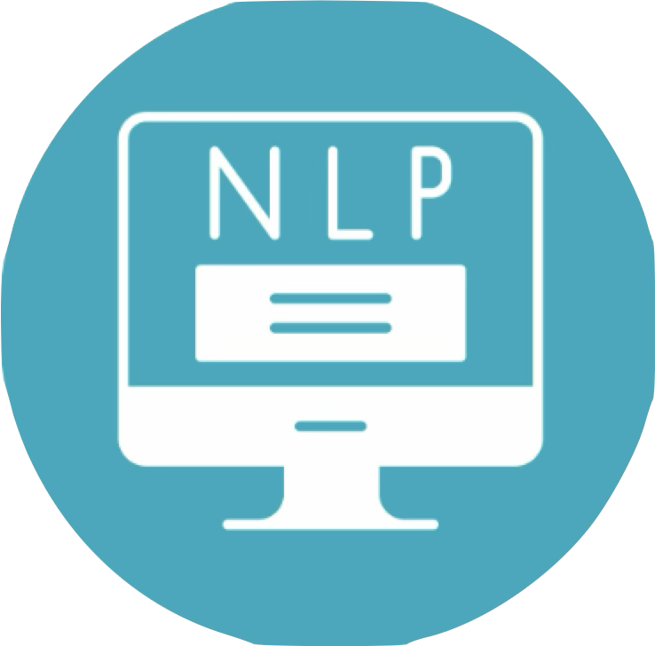
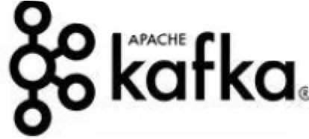




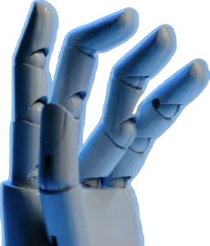
Frameworks/Technologies
stacks to be used
Brains | GPT-4, Specialized LLMs
Doer | LangChain (Agentic AI)
Home | Cloud (AWS / Azure)
Words | NLP ( NLTK)
Learning | ML (Scikit-learn, TensorFlow, PyTorch)
Memory | Databases (, MongoDB)
Face | Frontend (React, Vue.js, Tailwind CSS)
Backstage | Backend (Node.js, Python)
Connections | CAPIs (job boards, learning platforms)
Real-Time data | NScrapy, Kafka for market insights
Bias Mitigation | Fairlearn, LIME for fairness and transparency PyTorch)
Monitoring | ELK Stack, Mixpanel for performance and user analysis MongoDB)

Slide 10

What are the impact metrics that one can use to analyze the effect of the solution?
Metric | What to Measure | Why It Matters
User Engagement and Retention | Daily active users (DAU), session durations, and returning users. | Indicates how captivating and valuable the platform is for users over time.
Career Milestones Achieved | Number of users securing jobs, completing certifications, or transitioning careers. | Reflects the platform's effectiveness in helping users achieve their goals.
Guidance Accuracy and Satisfaction | Feedback on relevance and satisfaction of recommendations. | Demonstrates the AI’s ability to provide precise and actionable career advice.
Skill Development Impact | Increase in skills learned through platform-recommended courses or resources. | Highlights the platform’s role in bridging the skill gap for users.
Job Role Fit Success | Success rates of users placed in roles aligned with their skills and aspirations. | Validates the AI-driven role-fit analysis and its practical impact on users' careers.
Inclusivity and Accessibility | Percentage of diverse user groups benefiting from the platform. | Shows the system’s fairness and inclusivity in catering to all demographics.
Emotional Engagement Metrics | Effectiveness of AI counselors in addressing user concerns and emotional well-being. | Reflects the platform’s human-centric approach and emotional intelligence.
Network Building Outcomes | Number of connections made through suggested mentors or networking opportunities. | Demonstrates the added value of fostering professional relationships.
Global Reach and Scalability | User base growth across regions and multilingual adoption rates. | Proves the platform’s adaptability and ability to scale globally.

Slide 11

Future Scope
Virtual Reality Job Exploration: Offer immersive experiences to understand diverse job roles.
Enterprise Skill Gap Analysis: Help organizations address workforce skill gaps efficiently.
Integrated Career Ecosystem: Connect education, skills, and employment through collaborations.
Green Career Guidance: Promote eco-conscious jobs aligned with sustainability goals.
Emotional Support Tools: Build resilience during career transitions and high-pressure scenarios.
Global Opportunities Platform: Enable cross-border job applications with multilingual AI support.
Ethical AI Systems: Ensure unbiased, transparent, and private career guidance.

Slide 12
Github Link :https://github.com/ShrutikaM25/DreamBridge-CareerHub
Instructions to run :
1️⃣ Clone the Repository
git clone https://github.com/ShrutikaM25/DreamBridge-CareerHub
cd your-repo-name
2️⃣ Create a Virtual Environment (Optional but Recommended)
b# For Windows
python -m venv venv
venv\Scripts\activate
# For macOS/Linux
python3 -m venv venv
source venv/bin/activate
3️⃣ Install Dependencies
pip install -r requirements.txt
4️⃣ Run the Streamlit App
streamlit run app.py

Slide 13
